Slide 1
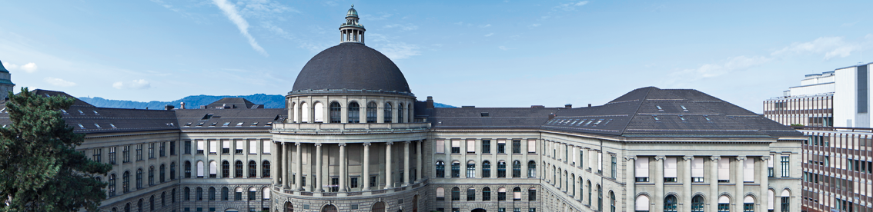
3D Object Recognition with Deep Networks
3D Vision – CVG – ETH Zurich
Instructors: Prof. Marc Pollefeys, Dr. Torsten Sattler
Teaching Assistant: Yagiz Aksoy, Johnasses Schönberger, Thomas Schöps, Peidung Liu
Supervisors: Martin Oswald, Pablo Speciale
Students: Adrian Schneuwly, Johannes Oswald, Tobias Grundmann

Slide 2
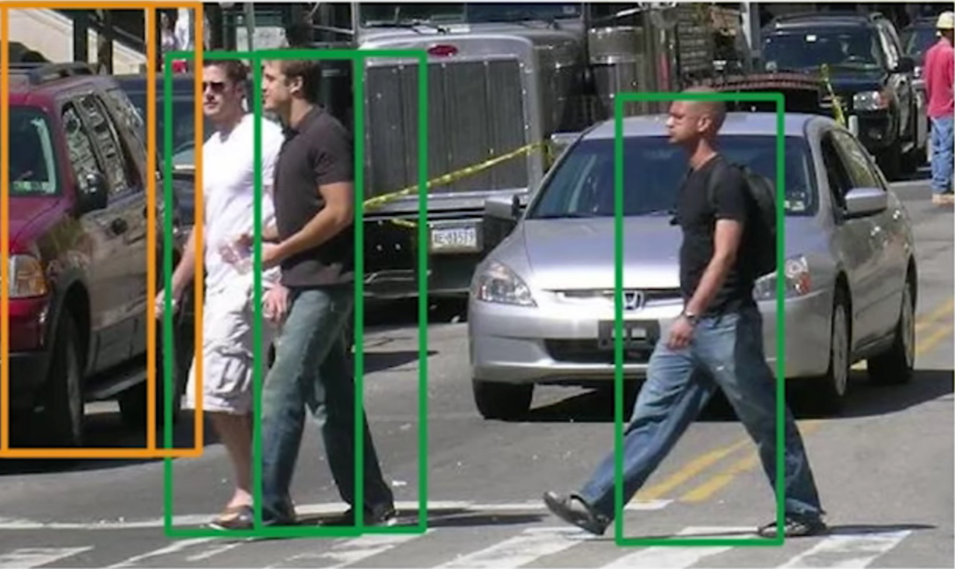
To understand the world autonomous systems need to recognize Objects

Slide 3
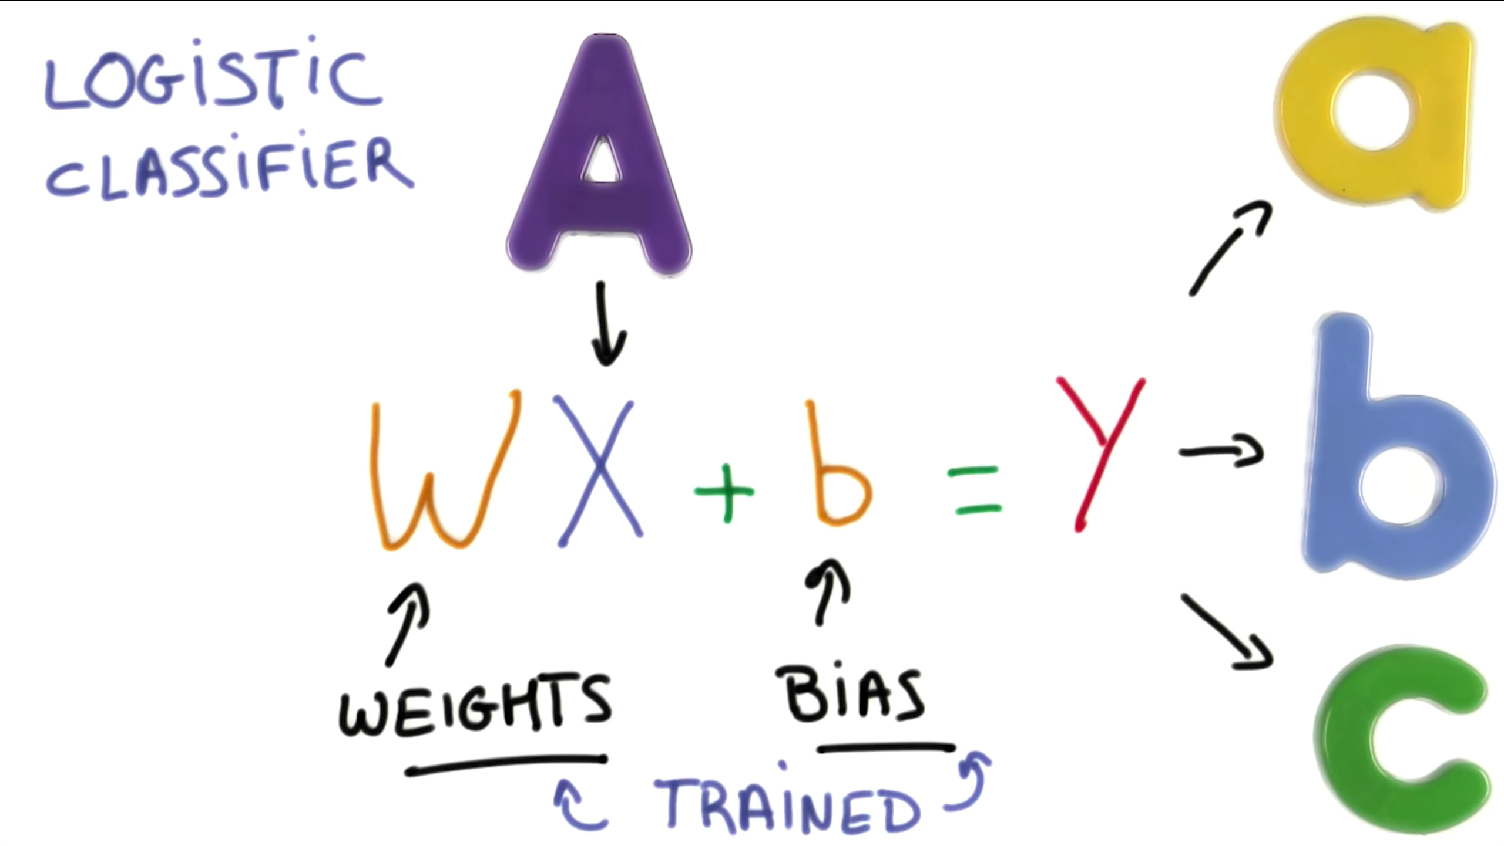
Object Recognition as a Classification Problem

Slide 4
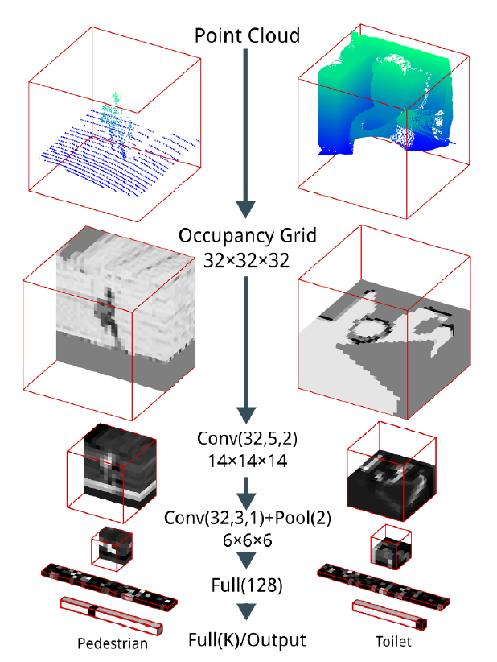
3D Convolutional Neural Network - VoxNet
Occupany Grid
Density Grid
Convolutional Layers
Convolution Through Feature Maps
Leaky rectified linear units(ReLU)
Pooling Layers
Down sampling by keeping max value
Fully Connected Layers
Linear combination through(ReLU)
Softmax
Source: Daniel Maturana and Sebastian Scherer; VoxNet: A 3D Convolutional Neural Network for Real-Time Object Recognition; IEEE/RSJ International Conference on Intelligent Robots and Systems; September; 2015

Slide 5
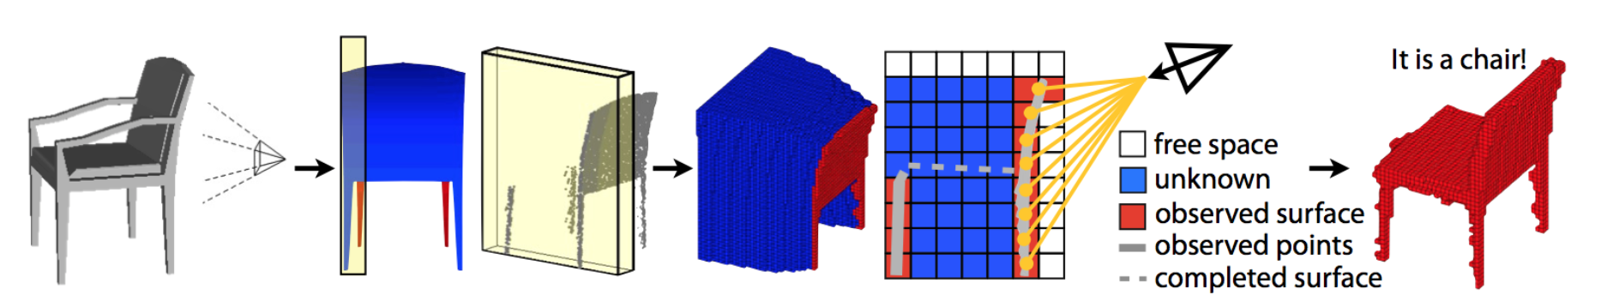
3D Objects in Voxilized Format (32x32x32)
Object
Occupancy Grid
Depth Data of particular view point
It’s a chair!

Slide 6
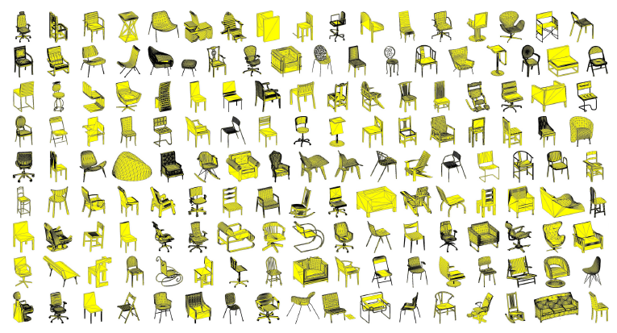
Training, Test Data - ModelNet
ModelNet
660 Objects
151128 CAD Models
ModelNet40
40 Objects
100 CAD Models per Object
Rotational Invariance through Data Augmentation
CNN Training through Stochastic Gradient Decent with Momentum
Source: Z. Wu, S. Song, A. Khosla, F. Yu, L. Zhang, X. Tang and J. Xiao; 3D ShapeNets: A Deep Representation for Volumetric Shapes; Proceedings of 28th IEEE Conference on Computer Vision and Pattern Recognition

Slide 7
Timeline
March
April
June
Understand 2D Object Recognition with Deep Networks
Get familiar with Machine Learning, Tensorflow, Papers‘ Approaches
Implement Neural Network
Turn 2D into 3D, Achieve Rotational Invariance
Train Neural Network (Time Intensive)
Fine Tuning & Evaluation
Build Application for Live Demo (Project Tango Data)

